Slide 1

Distributed Road Traffic Speed Monitoring
An EE4-T Final Year Project
Jeremy Chan
w/ Dr. Ed Stott
w/ Dr. Christos Papavassiliou
Notes:
Good morning.
My name is Jeremy Chan, and welcome to my final year project presentation, on creating a distributed road traffic speed monitoring system.

Slide 2
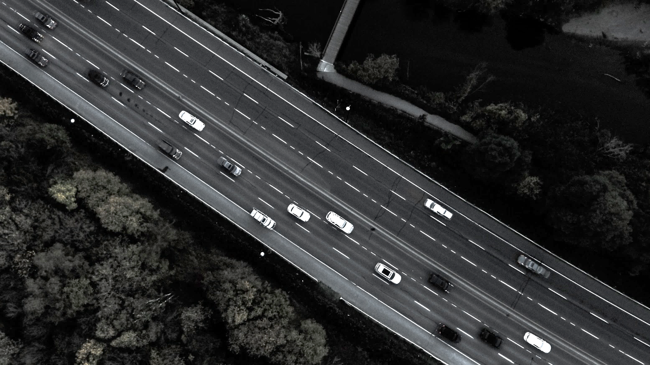
At a glance…
Motivation / Specification / High Level Design /
Implementation and Testing / Demo / Evaluation and Conclusion
Implementation based project
Catch speeding motorists using a camera and Raspberry Pi
Existing license plate recognition (LPR) technologies
New peer to peer network (P2P)
No government controlled central server
Social posting
Notes:
At a glance, this project is an implementation based project.
It uses a camera connected to a Raspberry Pi to catch speeding motorists by detecting their license plates, sharing it with others, and working out the average speed of the vehicle.
Details of speeding motorists can then be posted online on social platforms.
It leverages existing LPR technologies, but creates a NEW P2P network, eliminating the need for a central, government controlled, server
The rundown on this presentation is a general overview on the project details, followed by high level design of the individual components, followed by implementation and testing.
Finally, a demo, followed by an evaluation and a conclusion.

Slide 3



Motivation - Accident areas
72%
23%
95% of accidents not on motorway
Target residential areas
73%
22%
Built up
67%
30%
Non built up
43%
51%
Motorway
https://www.gov.uk/government/uploads/system/uploads/attachment_data/file/533293/rrcgb-main-results-2015.pdf
Notes:
The main motivation of the project comes from reducing casualties from speeding cars.
While the higher the speed, the higher the fatality rate, most of the casualties lie in residential and urban areas.
Therefore, the system is targeted at providing average speed checks across non-motorway areas.

Slide 4
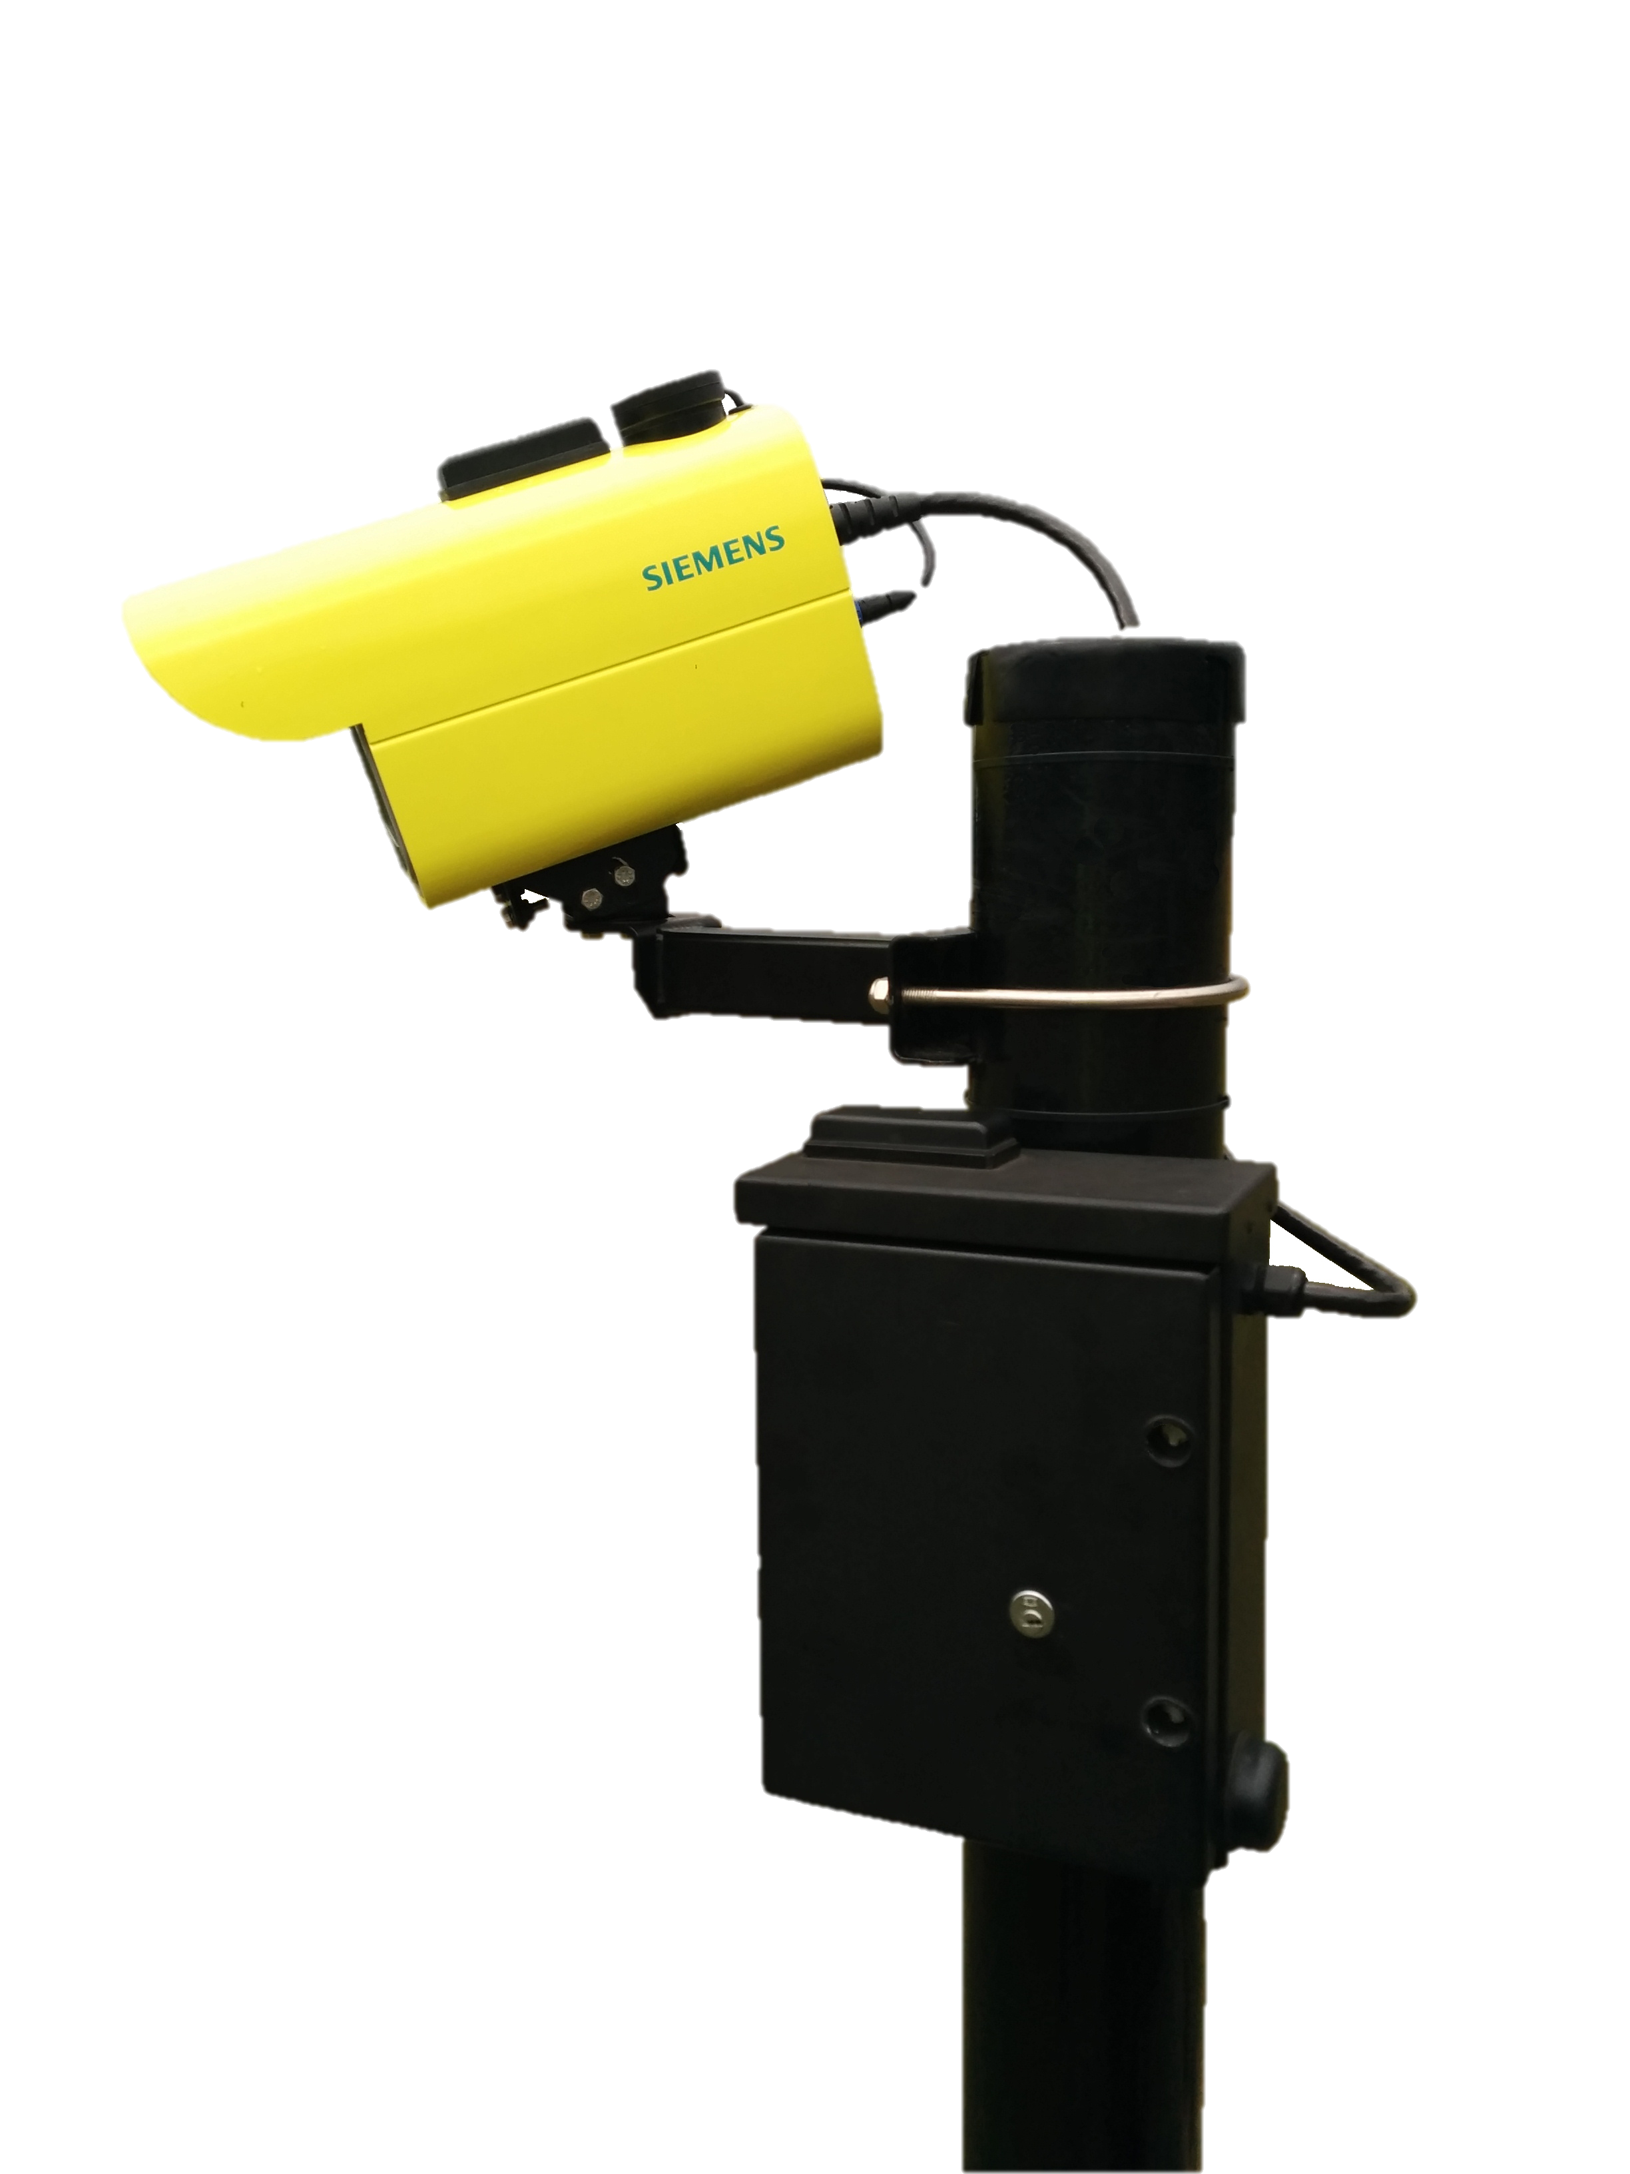
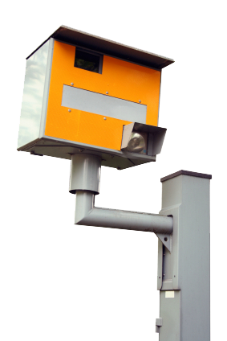
Motivation - Fixed point speed cameras
https://a1.muscache.com/locations/uploads/photo/image/22901/0_4200_0_2800_one_westside-los-angeles-quiet-residential-street-devon0289.jpg
Notes:
Regular average speed check cameras in all their yellow and orange glory are horrible to look at.
Putting a lot of them near homes would be detrimental to the streetscape, and therefore a discreet implementation is desired.

Slide 5

Motivation - Fixed point speed cameras
https://a1.muscache.com/locations/uploads/photo/image/22901/0_4200_0_2800_one_westside-los-angeles-quiet-residential-street-devon0289.jpg

Slide 6
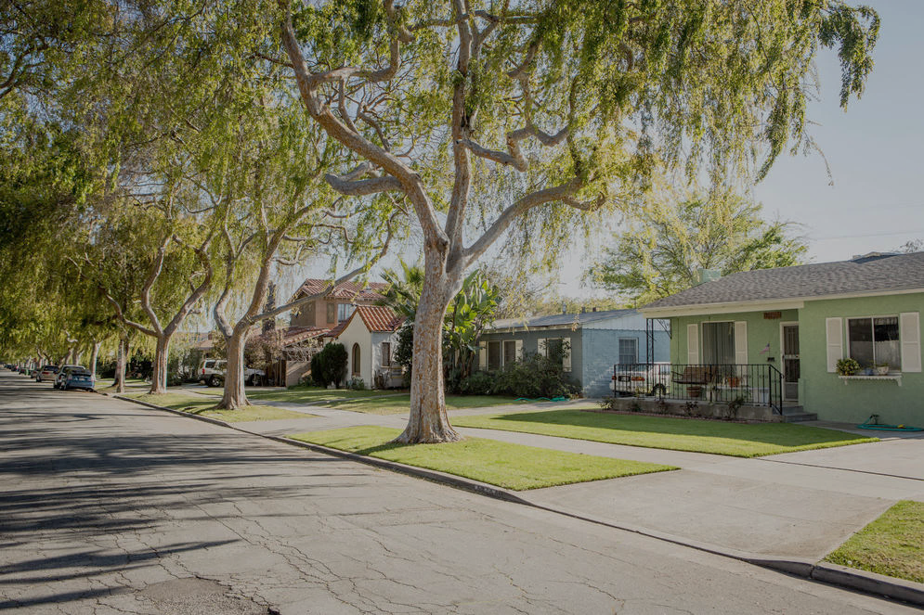
Motivation - Fixed point speed cameras
Detrimental to streetscape
Prefer discreet appearance
Only take speed at a point
https://a1.muscache.com/locations/uploads/photo/image/22901/0_4200_0_2800_one_westside-los-angeles-quiet-residential-street-devon0289.jpg
Notes:
Regular average speed check cameras in all their yellow and orange glory are horrible to look at.
Putting a lot of them near homes would be detrimental to the streetscape, and therefore a discreet implementation is desired.

Slide 7
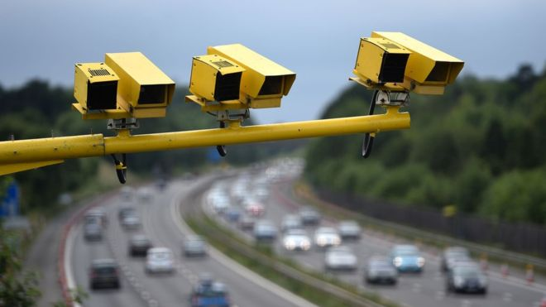
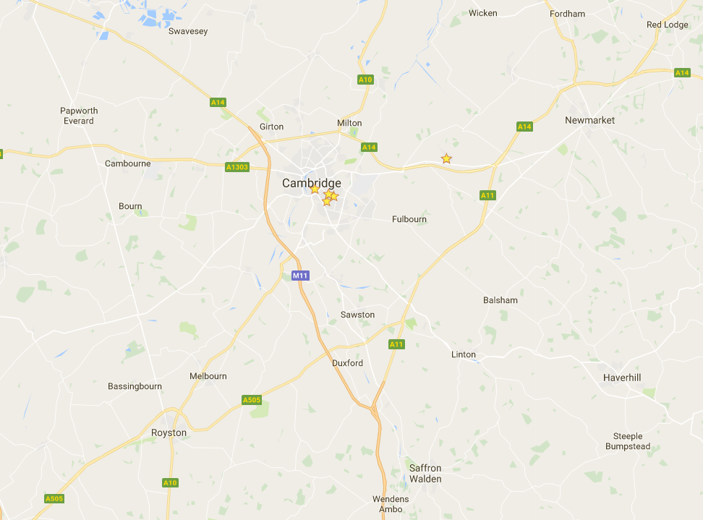
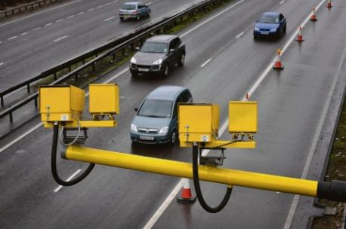
Motivation - Average speed cameras
None on non-trunk routes
http://www.trents.co.uk/wp-content/uploads/2014/12/Average-speed-camera.jpg
https://ichef-1.bbci.co.uk/news/660/cpsprodpb/0202/production/_89841500_033220635-2.jpg
Notes:
There are some license plate cameras on the market with different features like enhanced night time operation with superior digital signal processing.
However they are rather expensive and always use a central server to store the detected license plates.

Slide 8
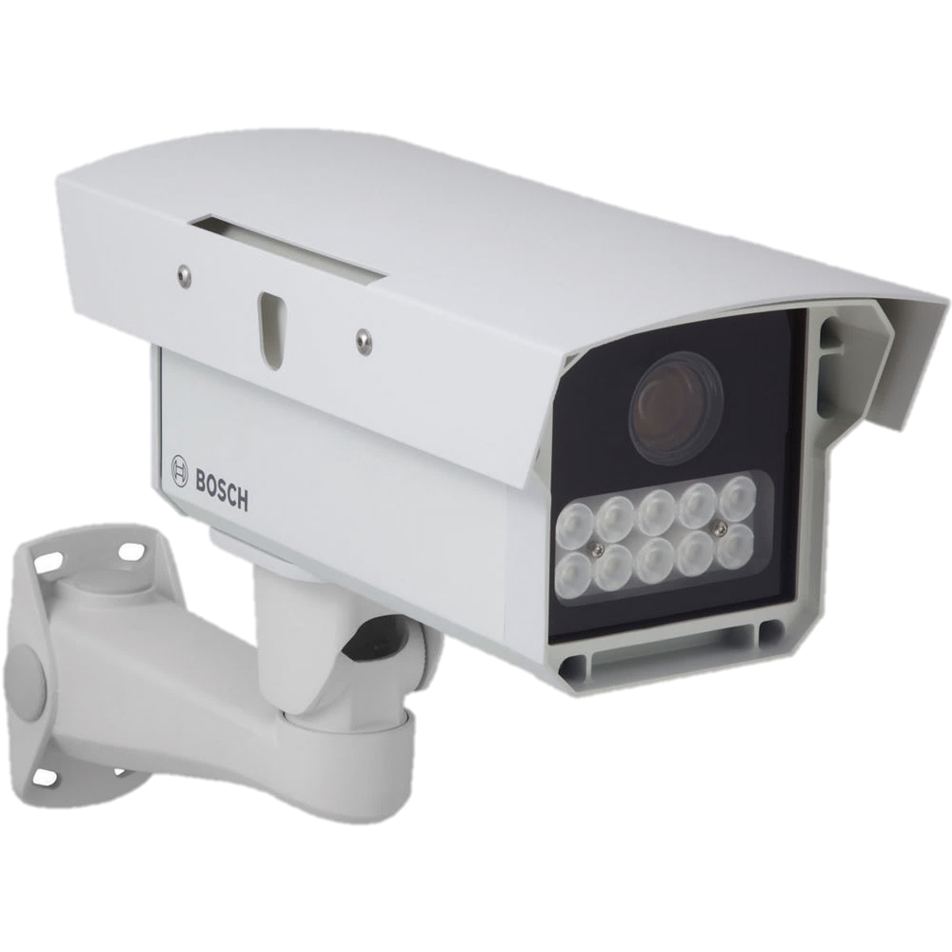
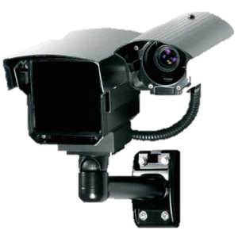
Motivation - Existing license plate cameras
Hard to buy for general public
>£ 1000
Proprietary storage of plates
https://www.bhphotovideo.com/images/images1000x1000/bosch_f_01u_245_613_dinion_capture_5000_license_1163861.jpg
https://www.securitycameraking.com/securityinfo/wp-content/uploads/2013/01/License-Plate-Capture-Camera-vs-License-Plate-Recognition-Camera-21-300x300.gif
Notes:
There are some license plate cameras on the market with different features like enhanced night time operation with superior digital signal processing.
However they are rather expensive and always use a central server to store the detected license plates.

Slide 9
Motivation - Summary
New system should:
Target general public
Priced reasonably
Not aim to directly ticket offender
Use as evidence and leverage for demands
Notes:
There are some license plate cameras on the market with different features like enhanced night time operation with superior digital signal processing.
However they are rather expensive and always use a central server to store the detected license plates.

Slide 10
Product Specification - Main Deliverables
Implement a UK number plate recognition system using existing computer vision algorithms on a low-cost, readily available hardware platform.
Set up a peer-to-peer network to share vehicle passing times and detect violations without the need for a central server.
Publish photo evidence of any violations
Notes:
Therefore, the main deliverables of the project were formulated as follows:
The system should leverage existing computer vision algorithms to provide license plate recognition capabilities
For sake of simplicity, no custom plates, and only UK format
A peer to peer network should be created to share the detected plates with no need for a central server
The license plates should be able to be published online for further police action

Slide 11
Product Specification - Main Deliverables
Implement a UK number plate recognition system using existing computer vision algorithms on a low-cost, readily available hardware platform.
Set up a peer-to-peer network to share vehicle passing times and detect violations without the need for a central server.
Publish photo evidence of any violations
Notes:
Therefore, the main deliverables of the project were formulated as follows:
The system should leverage existing computer vision algorithms to provide license plate recognition capabilities
For sake of simplicity, no custom plates, and only UK format
A peer to peer network should be created to share the detected plates with no need for a central server
The license plates should be able to be published online for further police action

Slide 12
Product Specification - Main Deliverables
Implement a UK number plate recognition system using existing computer vision algorithms on a low-cost, readily available hardware platform.
Set up a peer-to-peer network to share vehicle passing times and detect violations without the need for a central server.
Publish photo evidence of any violations
Notes:
Therefore, the main deliverables of the project were formulated as follows:
The system should leverage existing computer vision algorithms to provide license plate recognition capabilities
For sake of simplicity, no custom plates, and only UK format
A peer to peer network should be created to share the detected plates with no need for a central server
The license plates should be able to be published online for further police action

Slide 13
Product Specification - Main Deliverables
Implement a UK number plate recognition system using existing computer vision algorithms on a low-cost, readily available hardware platform.
Set up a peer-to-peer network to share vehicle passing times and detect violations without the need for a central server.
Publish photo evidence of any violations
Notes:
Therefore, the main deliverables of the project were formulated as follows:
The system should leverage existing computer vision algorithms to provide license plate recognition capabilities
For sake of simplicity, no custom plates, and only UK format
A peer to peer network should be created to share the detected plates with no need for a central server
The license plates should be able to be published online for further police action

Slide 14
Product Specification - Advanced Deliverables
Have a standalone mode in case there is no one in the network
Be able to join/leave/return to the network easily
Make the network secure against rogue peers
Package the system so that it can be easily installed in a home by an inexperienced user

Slide 15
Product Specification - Advanced Deliverables
Have a standalone mode in case there is no one in the network
Be able to join/leave/return to the network easily
Make the network secure against rogue peers
Package the system so that it can be easily installed in a home by an inexperienced user

Slide 16
Product Specification - Advanced Deliverables
Have a standalone mode in case there is no one in the network
Be able to join/leave/return to the network easily
Make the network secure against rogue peers
Package the system so that it can be easily installed in a home by an inexperienced user

Slide 17
Product Specification - Advanced Deliverables
Have a standalone mode in case there is no one in the network
Be able to join/leave/return to the network easily
Make the network secure against rogue peers
Package the system so that it can be easily installed in a home by an inexperienced user

Slide 18
Product Specification - Advanced Deliverables
Have a standalone mode in case there is no one in the network
Be able to join/leave/return to the network easily
Make the network secure against rogue peers
Package the system so that it can be easily installed in a home by an inexperienced user

Slide 19




Envisioned System
1
2
(1) 9:41 pm
(1) 9:41 pm
(2) 9:44 pm
(2) 9:44 pm
3
Yellow – locally detected
White – peer detected
(1) 9:41 pm
(2) 9:44 pm

Slide 20
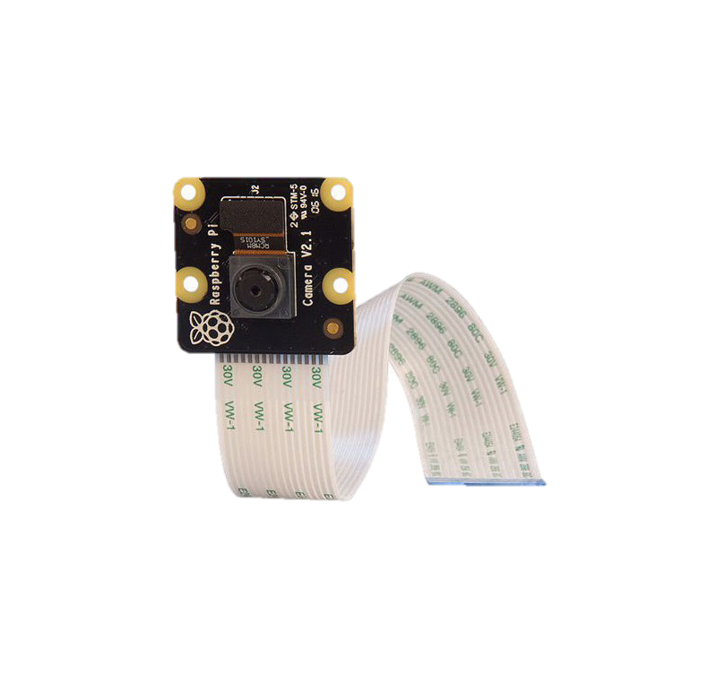

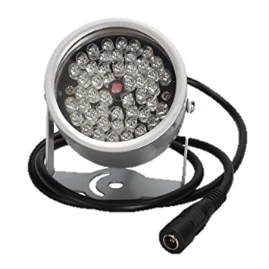

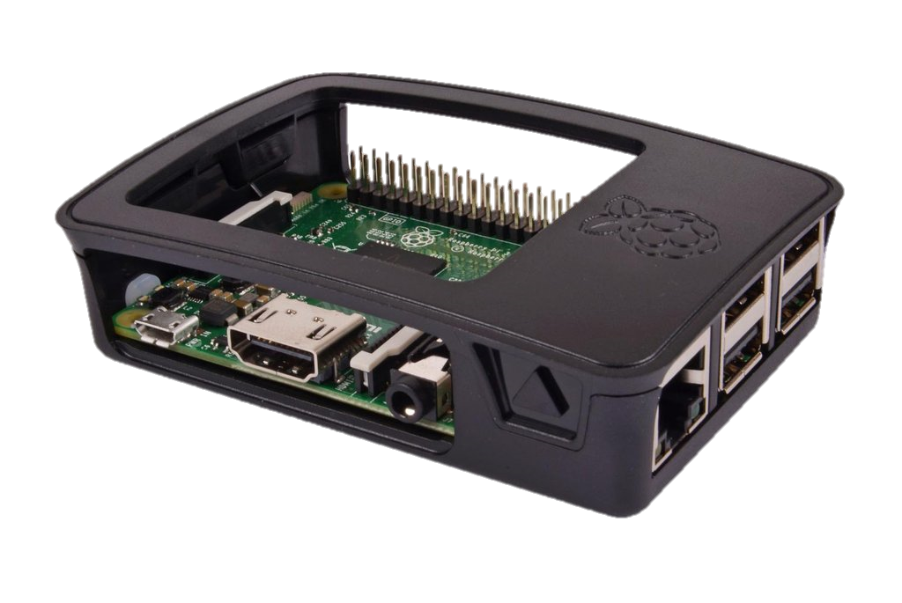


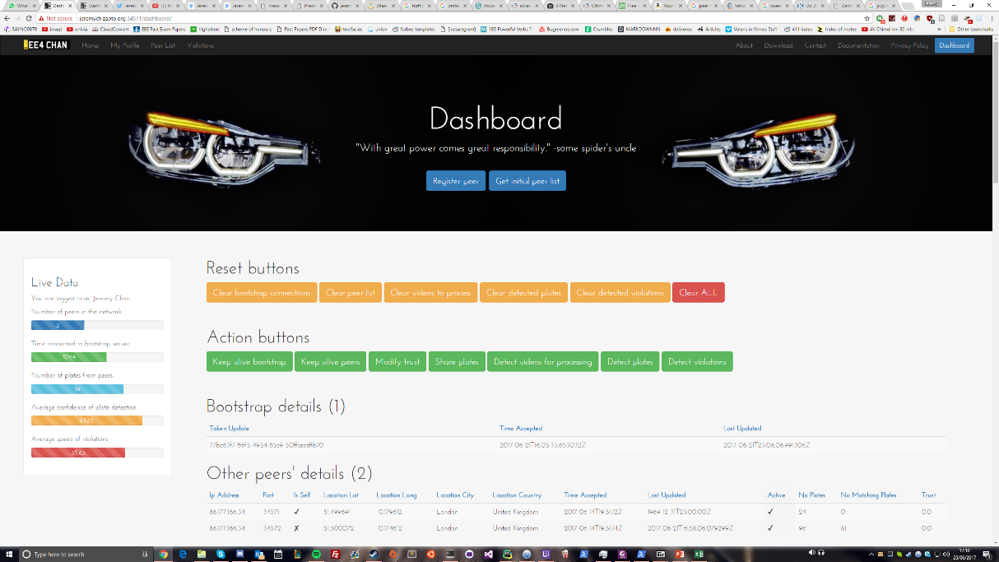
High Level Design
License Plate Detection
Peer to Peer Network
Web Interface
3 well defined modules
Readily available components
Users have control over data

Slide 21
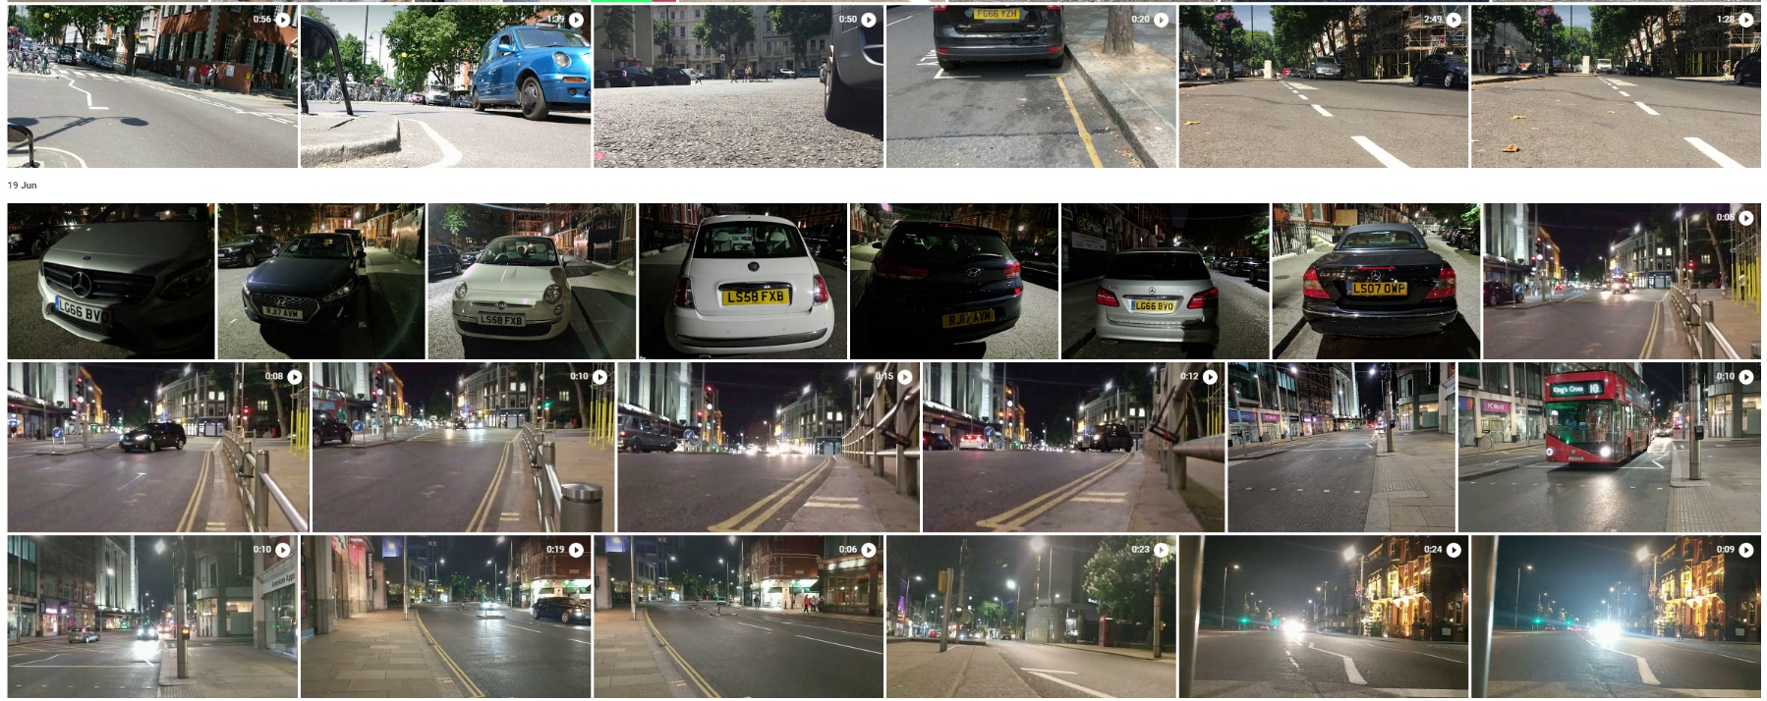
License Plate Recognition - Aim
Get license plates of cars
Function in multiple angles and lighting conditions

Slide 22
License Plate Recognition - Design
Store videos locally using motion detection
Detect license plates using OpenALPR
Extract unique plates
Multiple parameters for tweaking
Store plates with metadata in database
Consecutive frames will likely be the same car
Process videos when idle
Time
Location
OpenALPR computationally expensive
Buffer videos
Survive busy periods and power outages

Slide 23
License Plate Recognition - Fuzzy Grouping
<<<<<1< LG65FBO <2< LG65FBP <3< LG65FBO <4< FE16RBX <5< LTZ1077 <6< LTZ077 <7< LTZ107
 | Plate1 | Plate 2 | String Similarity (0.75)
1-2 | LG65FBO | LG65FBP | 0.857
2-3 | LG65FBP | LG65FBO | 0.857
3-4 | LG65FBO | FE16RBX | 0.285
4-5 | FE16RBX | LTZ1077 | 0.143
5-6 | LTZ1077 | LTZ077 | 0.923
6-7 | LTZ077 | LTZ107 | 0.857
Robust separation of unique vehicles
Works with misreads
Sort groups by confidence

Slide 24
License Plate Recognition - Fuzzy Grouping
<<<<<1< LG65FBO <2< LG65FBP <3< LG65FBO <4< FE16RBX <5< LTZ1077 <6< LTZ077 <7< LTZ107
 | Plate1 | Plate 2 | String Similarity (0.75)
1-2 | LG65FBO | LG65FBP | 0.857
2-3 | LG65FBP | LG65FBO | 0.857
3-4 | LG65FBO | FE16RBX | 0.285
4-5 | FE16RBX | LTZ1077 | 0.143
5-6 | LTZ1077 | LTZ077 | 0.923
6-7 | LTZ077 | LTZ107 | 0.857
Robust separation of unique vehicles
Works with misreads
Sort groups by confidence

Slide 25
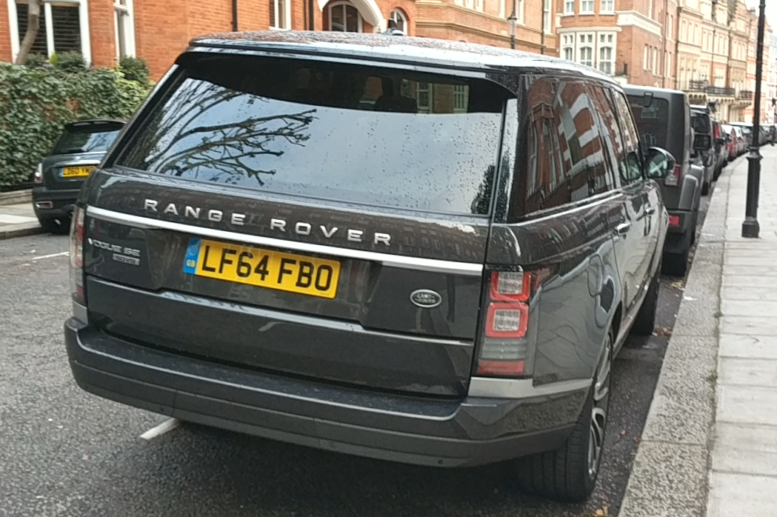
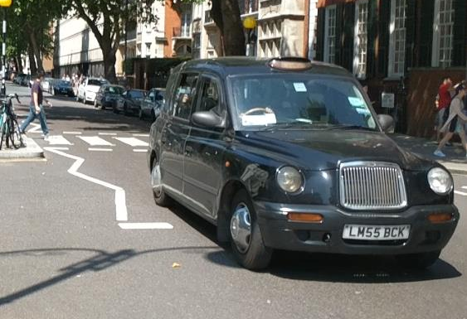
License Plate Recognition - Testing
LF64FBO
LM55BCK

Slide 26
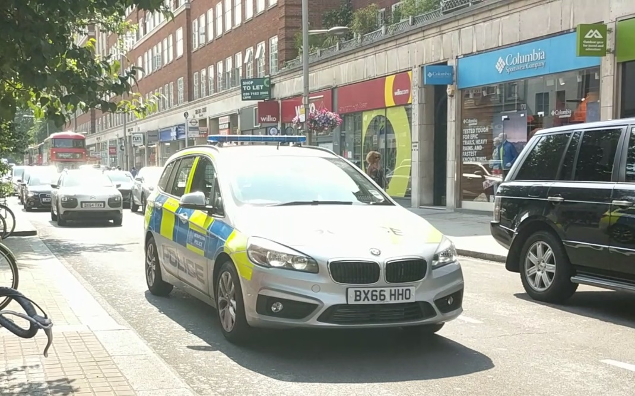
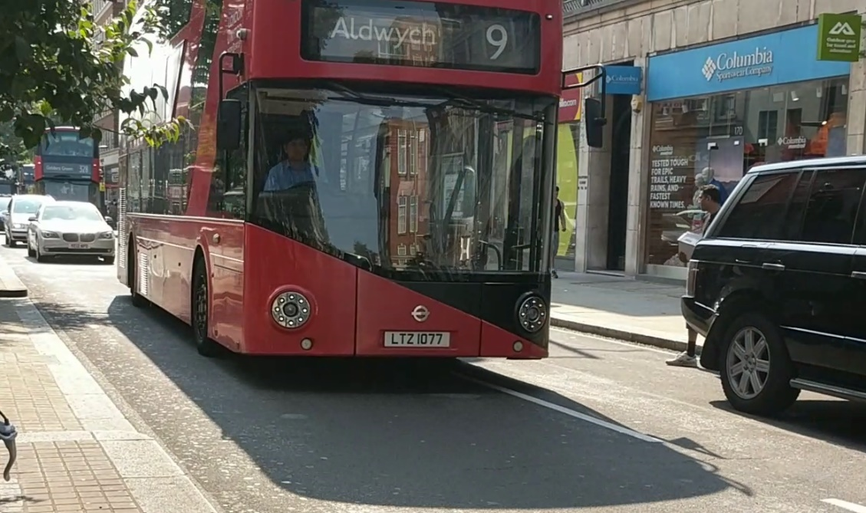
License Plate Recognition - Testing
BX66HHO
LTZ1077

Slide 27
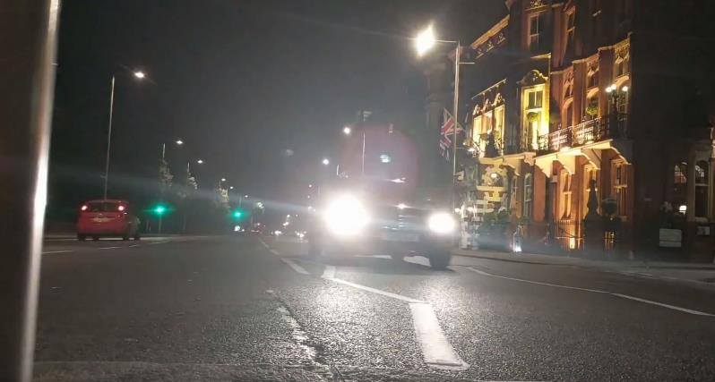
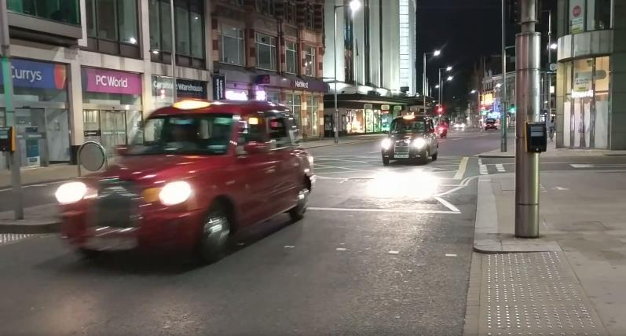
License Plate Recognition - Testing
--
--

Slide 28
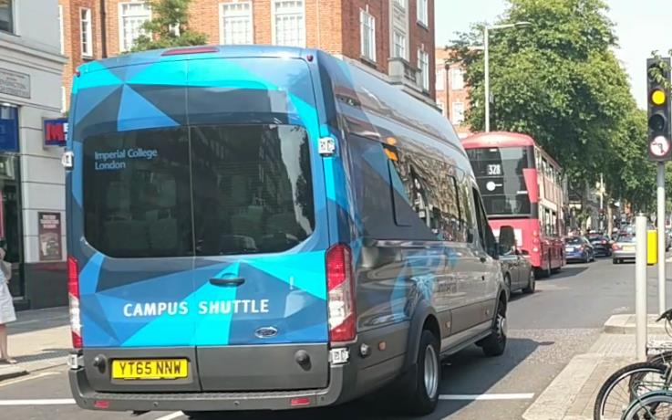
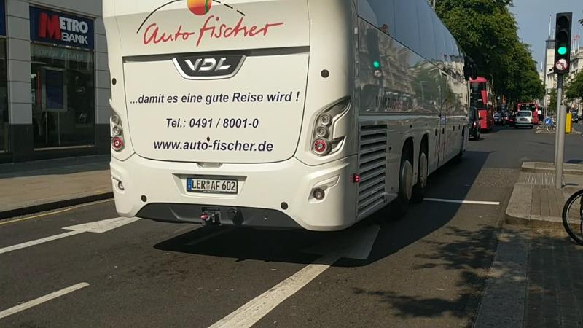
License Plate Recognition - Testing
5HUTTLE
18001

Slide 29






License Plate Recognition - Matching
@ Letter
# Number
@@##@@@ or @@@####

Slide 30
License Plate Recognition - Matching
@ Letter
# Number
@@##@@@ or @@@####
LPR output compared with manual
Max 100%

Slide 31
False positive slide

Slide 32
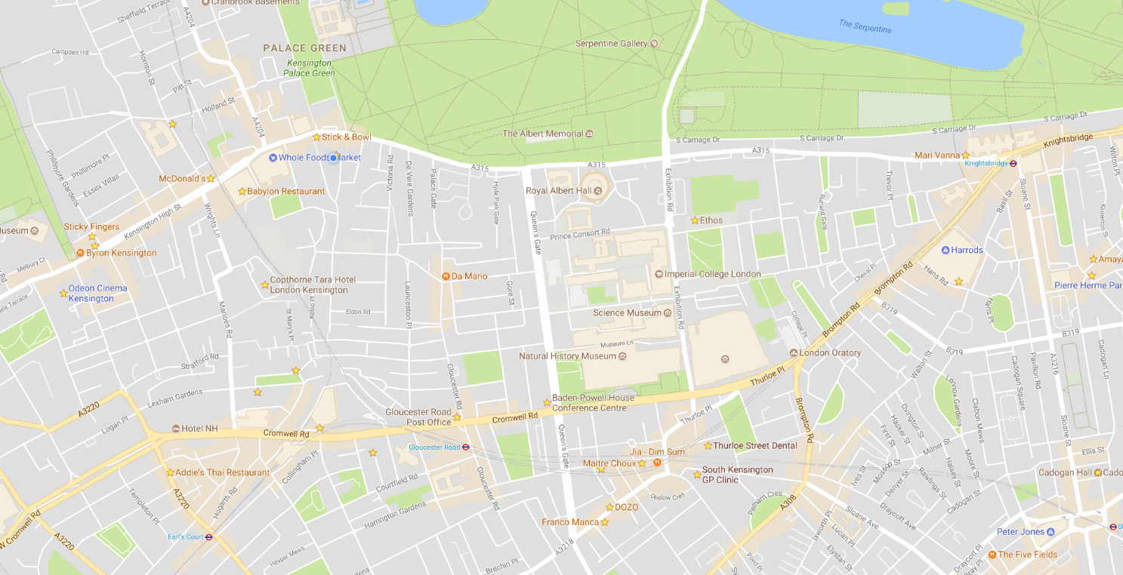
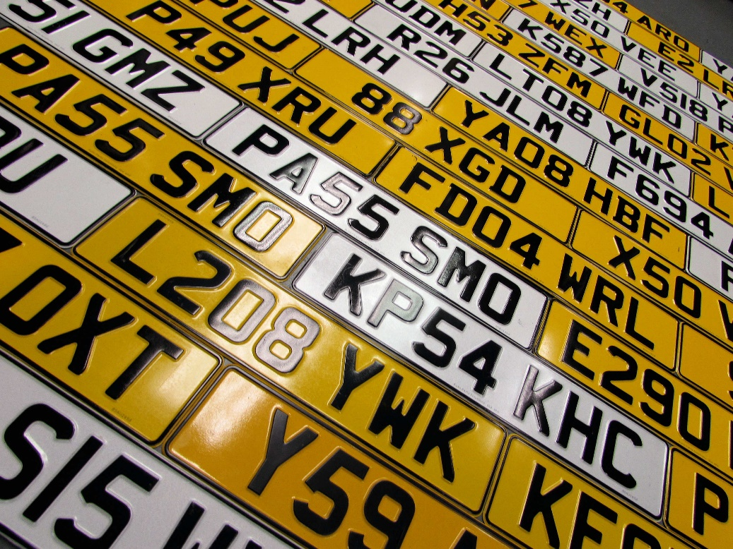
Peer to Peer Network - Aim
Transmit detected plates to other peers
Work out average speed between peer locations
http://pressednumberplates.co.uk/wp-content/uploads/2016/06/Pressed-Number-Plates.jpg

Slide 33
Peer to Peer Network – Network Transactions
Register*
Get list of peers
Keep alive
Send plates
Detect violations
Modify trust of peer
Bootstrap the network
Maintain the network
Security issues
*) Requires central server
Adapted from https://en.wikipedia.org/wiki/Peer-to-Peer_Protocol_(P2PP)

Slide 34
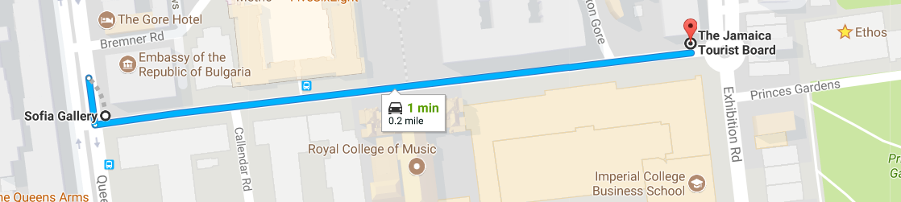

Peer to Peer Network - Aim
http://pressednumberplates.co.uk/wp-content/uploads/2016/06/Pressed-Number-Plates.jpg

Slide 35
Peer to Peer Network - Aim
http://pressednumberplates.co.uk/wp-content/uploads/2016/06/Pressed-Number-Plates.jpg

Slide 36

Peer to Peer Network - Server
ID: fbbb1cbf-7887-4cc6-9bbf-16707e11367e
ID: 01ed4cfa-6c5b-476f-a6f8-4c6d0bcd5975
GET
POST
PATCH
DELETE
encryption
authentication
ID: 4feb662e-f50a-4088-bafe-ce75b421d50c
P2P on top of web server
API
Unique ID authentication
Local encryption

Slide 37







Peer to Peer Network - Design
Tried, tested, scalable framework
Most security issues taken care of

Slide 38
Peer to Peer Network - Trust System
Self | Peer (1min)
LK14VJV
LX04CZT
RF66BEU
KN14BVY
SH14PVZ
LL12EFH

Slide 39
Peer to Peer Network - Trust System
Self | Peer (1min)
LK14VJV | LK14VJV
LX04CZT | LX04CZT
RF66BEU | RF66BEU
KN14BVY | KN14BVY
SH14PVZ | SH14PVZ
LL12EFH | LL12EFH

Slide 40
Peer to Peer Network - Trust System
Self | Peer (10min)
LK14VJV | LK14VJV
LX04CZT
RF66BEU | RF66BEU
KN14BVY | KN14BVY
SH14PVZ
LL12EFH

Slide 41
Peer to Peer Network - Trust System
Self | Rogue Peer
LK14VJV | HI MOM
LX04CZT | !@$%^&**
RF66BEU | FAKE_FAKE
KN14BVY | AAAAAAA
SH14PVZ
LL12EFH

Slide 42
Peer to Peer Network - Trust System
Ignore rogue
Reward genuine, matching plates
Prevent fake plates
Prevent leeching

Slide 43
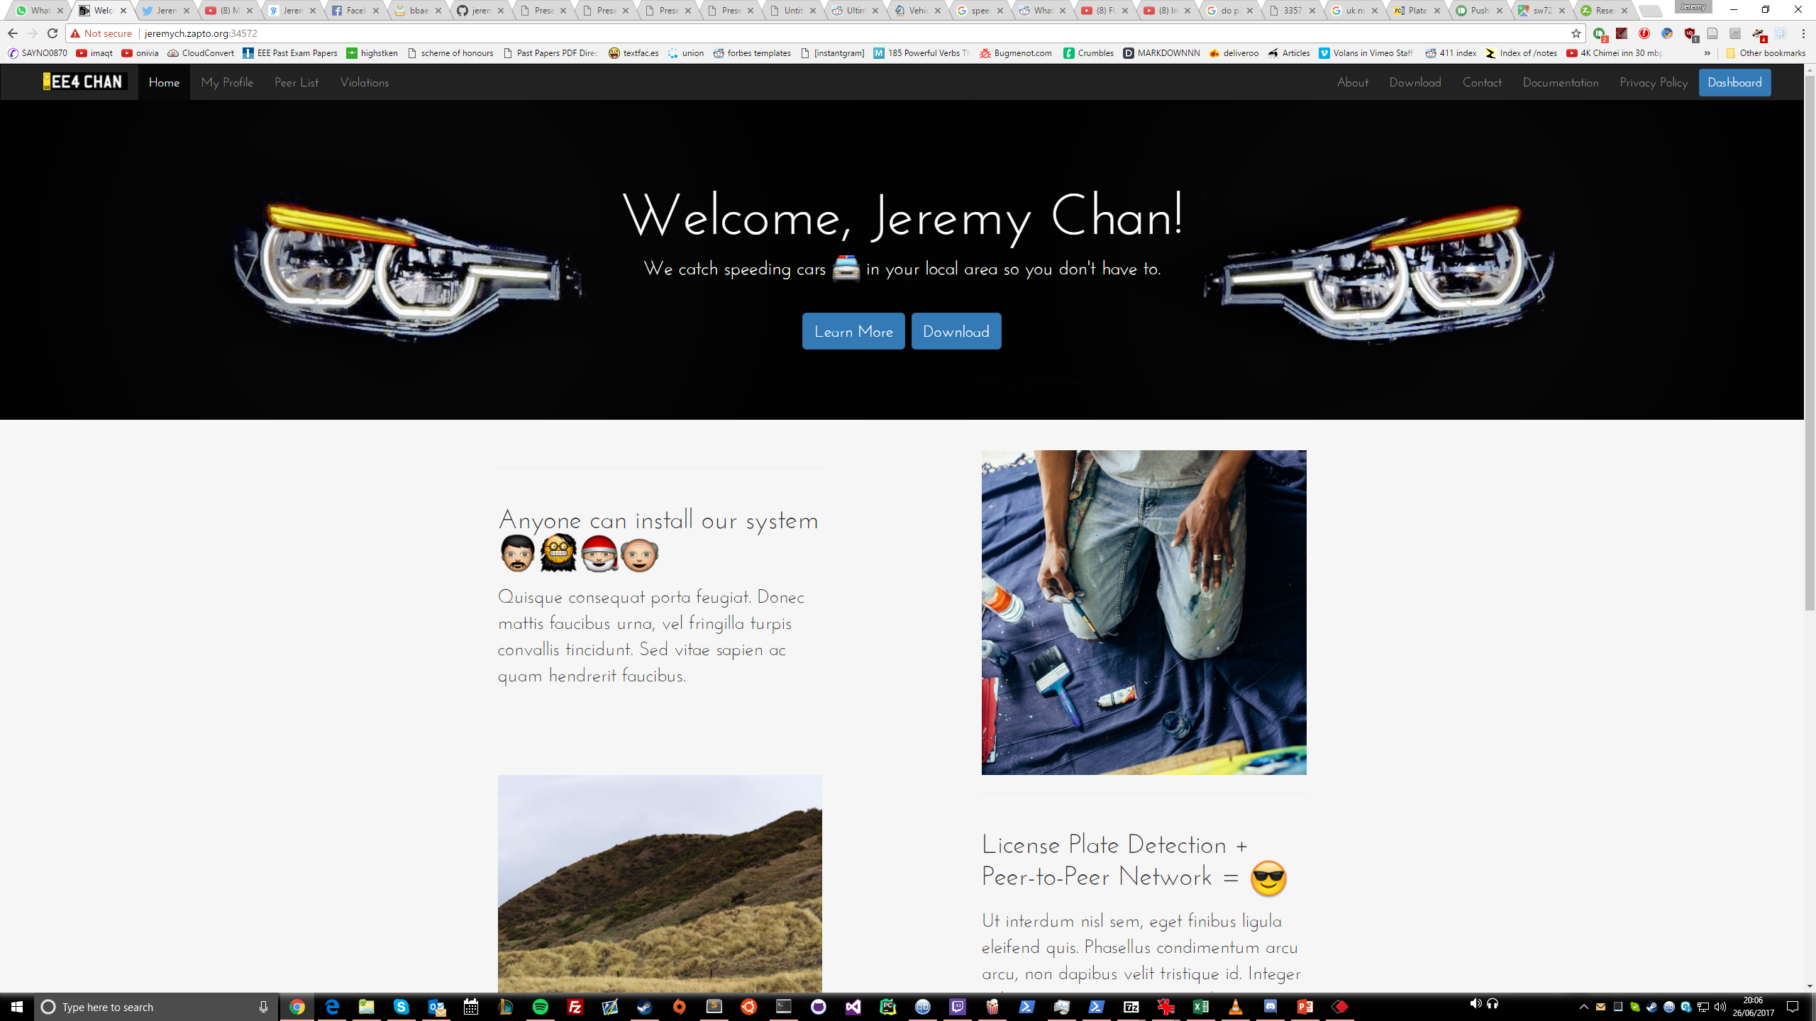
Web Interface - Aim
What the user sees
Dashboard to control network
Post detected violations on social networks

Slide 44
Demo
Modifications
Pre-recorded video
Live motion detection unused

Slide 45

Evaluation
Implement a number plate recognition system using existing computer vision algorithms on a low-cost, readily available hardware platform.
Set up a peer-to-peer network to share vehicle passing times and detect violations without the need for a central server*.
Publish photo evidence of any violations
All main deliverables achieved
*) Except when bootstrapping

Slide 46
Evaluation
Use the changes in the number plate geometry as the vehicle passes to detect the instantaneous speed of a vehicle
Implement automatic peer discovery
Add an encryption layer
Package the system so that it can be easily installed in a home by an inexperienced user.
All but 1 advanced deliverable achieved

Slide 47
Conclusion
Challenging project
Very open ended on implementation
Usable immediately
Revisit performance and night time issues with LPR
Consider refactoring P2P to be standalone
Scalability testing
Attempt overnight test

Slide 48
Thank you
http://github.com/jeremych1000/ee4-FYP/
©2017 Jeremy Chan. All rights reserved. | Powered by Django and OpenALPR | Created with love from the United Kingdom

